Slide 1
Residual Interpolation for Color Image Demosaicking
13-06-2024 Dinh Hoang Luan
Notes:
Good morning/afternoon everyone.
My name is Dinh Hoang Luan, and today I’ll be presenting a demosaicking technique called Residual Interpolation (RI)

Slide 2
Content
Overview Residual Interpolation Algorithm
Green Interpolation Channel
Red/Blue Interpolation Channel
Result
Evaluation
Notes:
Fig Left shows the interpolation process of the R pixel values by using the color difference interpolation. After the G channel has been interpolated. Then, the color differences (R-G) are calculated at the R pixels and the color difference interpolation is performed. Finally, the G image is added to the interpolated color difference image to acquire the interpolated R image.
Fig Right shows the interpolation process of the R pixel values by using the proposed residual interpolation. After the G channel has been interpolated, which is the same as the color difference interpolation. Then, the method generate the tentative estimate of the R image (Rˇ) and calculate the residuals between the observed and the tentatively esti-mated R pixel values (R −Rˇ) at the R pixels. After that, we will interpolate the residuals instead of the color differences. Finally,
the tentative estimate of the R image is added to the interpolated residual image to acquire the interpolated R image.
A tentative estimate is a first guess. It is not the final or exact result. It is used to start the process, and then improved later with more accurate methods.

Slide 3
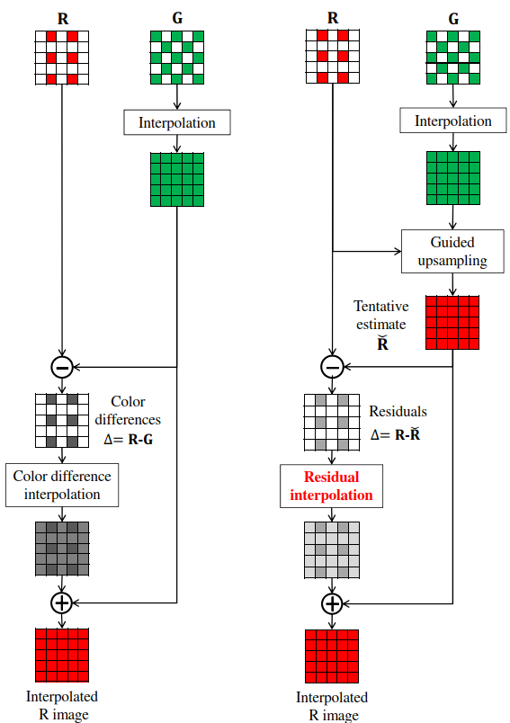
Overview Residual Interpolation Algorithm
The Residual Interpolation algorithm is based on the Gradient-Based Threshold Free (GBTF) algorithm and tries to improve the image quality by using a technique called residual interpolation.
The residuals (small difference) will be ﬂatter than the standard color differences, which leads to better results for color image demosaicking.
This method does not use color differences. Instead, it first generate tentative estimates by using a Guided Filter. Then, it finds the residuals between the tentative estimates and the observed (pixel value). Finally, it uses that residuals to interpolate in the missing parts.
Link of paper: Residual_Interpolation
The interpolation of R pixel value
By using GBTF and RI algorithm
Notes:
Fig Left shows the interpolation process of the R pixel values by using the color difference interpolation. After the G channel has been interpolated. Then, the color differences (R-G) are calculated at the R pixels and the color difference interpolation is performed. Finally, the G image is added to the interpolated color difference image to acquire the interpolated R image.
Fig Right shows the interpolation process of the R pixel values by using the proposed residual interpolation. After the G channel has been interpolated, which is the same as the color difference interpolation. Then, the method generate the tentative estimate of the R image (Rˇ) and calculate the residuals between the observed and the tentatively esti-mated R pixel values (R −Rˇ) at the R pixels. After that, we will interpolate the residuals instead of the color differences. Finally,
the tentative estimate of the R image is added to the interpolated residual image to acquire the interpolated R image.
A tentative estimate is a first guess. It is not the final or exact result. It is used to start the process, and then improved later with more accurate methods.

Slide 4
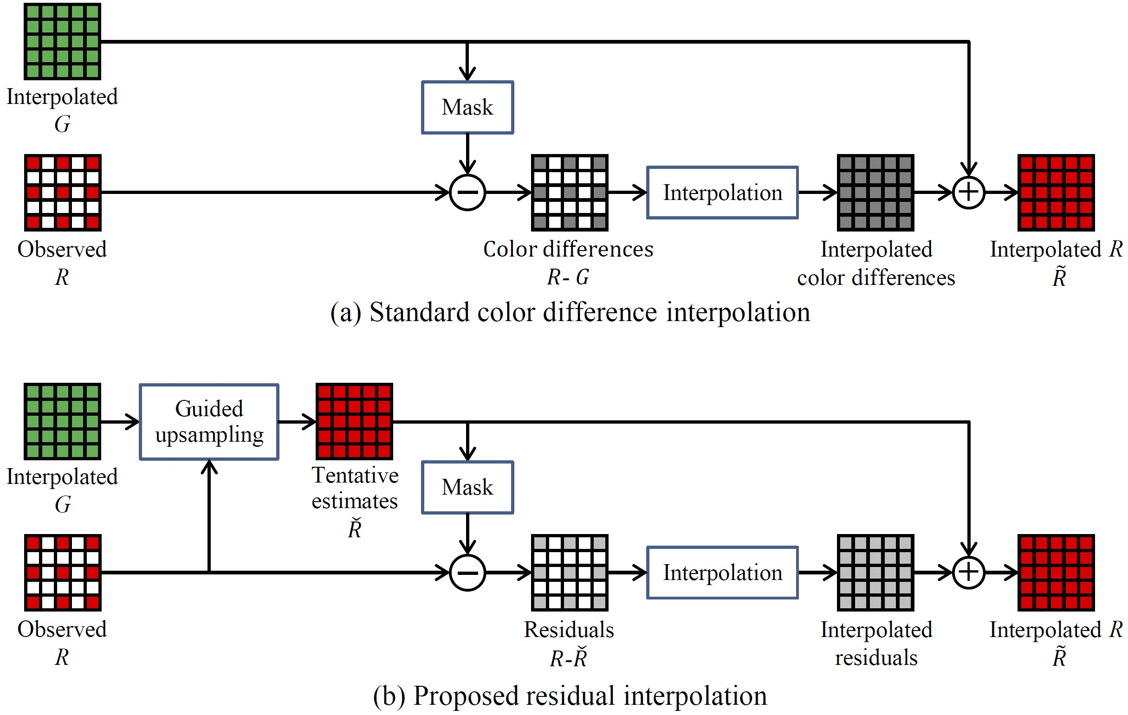
Overview Residual Interpolation Algorithm
The Residual Interpolation algorithm is based on the Gradient-Based Threshold Free (GBTF) algorithm and tries to improve the image quality by using a technique called residual interpolation.
This method does not use color differences. Instead, it first generate tentative estimates by using a Guided Filter. Then, it finds the residuals between the tentative estimates and the observed (pixel value). Finally, it uses that residuals to interpolate in the missing parts.
The residuals (small difference) will be ﬂatter than the standard color differences, which leads to better results for color image demosaicking.
Link of paper: Residual_Interpolation
The interpolation of R pixel value by using GBTF and RI algorithm
Notes:
Fig Left shows the interpolation process of the R pixel values by using the color difference interpolation. After the G channel has been interpolated. Then, the color differences (R-G) are calculated at the R pixels and the color difference interpolation is performed. Finally, the G image is added to the interpolated color difference image to acquire the interpolated R image.
Fig Right shows the interpolation process of the R pixel values by using the proposed residual interpolation. After the G channel has been interpolated, which is the same as the color difference interpolation. Then, the method generate the tentative estimate of the R image (Rˇ) and calculate the residuals between the observed and the tentatively esti-mated R pixel values (R −Rˇ) at the R pixels. After that, we will interpolate the residuals instead of the color differences. Finally,
the tentative estimate of the R image is added to the interpolated residual image to acquire the interpolated R image.
A tentative estimate is a first guess. It is not the final or exact result. It is used to start the process, and then improved later with more accurate methods.

Slide 5
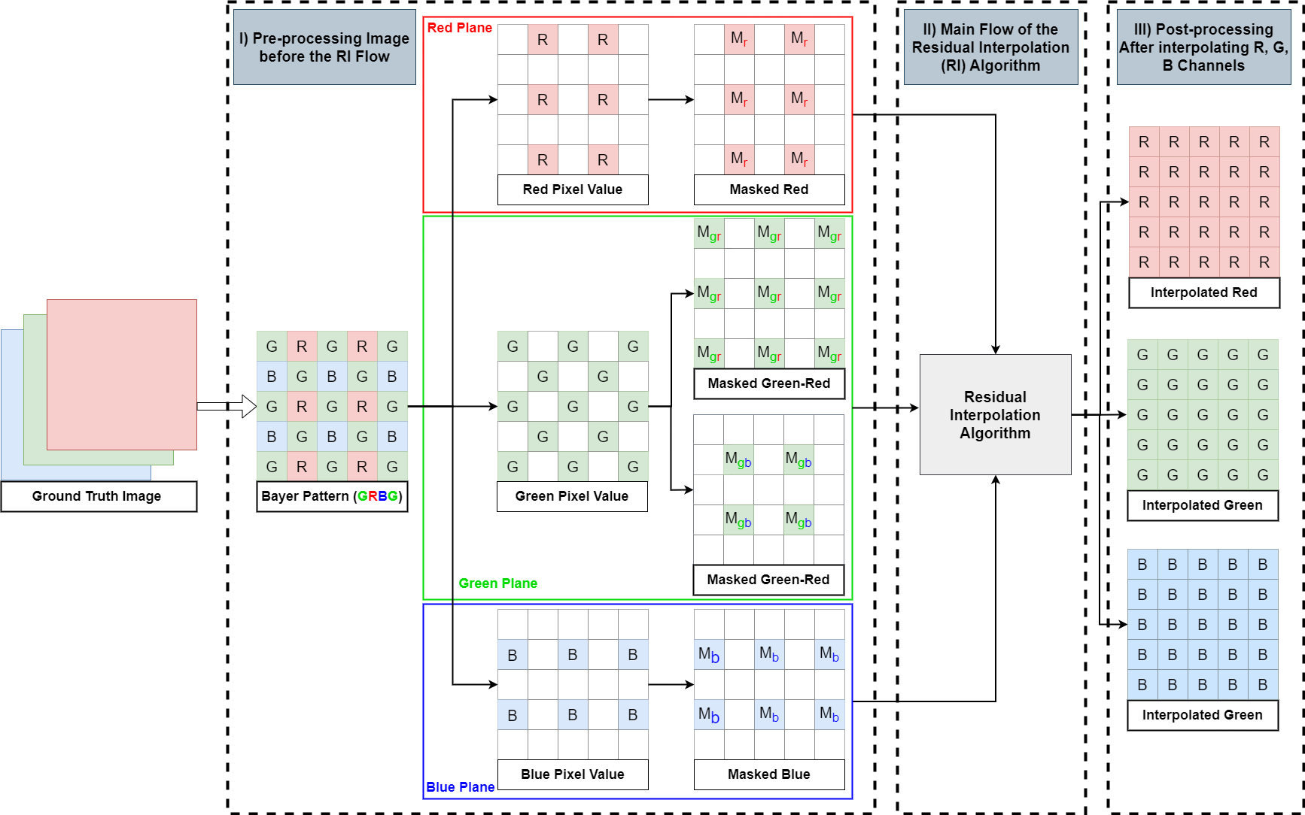
Overview Residual Interpolation Algorithm
In the pre-processing stage, the ground truth image is first converted into a Bayer-patterned image (e.g., GRBG format). The Bayer image is then separated into individual color planes Red, Green, and Blue each accompanied by a binary mask that indicates the positions of known (sampled) pixel values.
Mr (i,j) = 1, if the position Mr (j,j) have the red pixel value.
After processing, the RI algorithm generates fully interpolated Red, Green, and Blue channels.
The workflow pre-processing, Main flow and Post-processing of RI
Notes:
The RI workflow consists of three stages: preprocessing, main flow, and post-processing.
We start with a ground truth image and generate a Bayer-patterned version. We then separate the color planes and apply binary masks to mark known pixels.
M is a binary mask at the pixel (i, j), which is one for the sampled target pixels and zero for the others

Slide 6
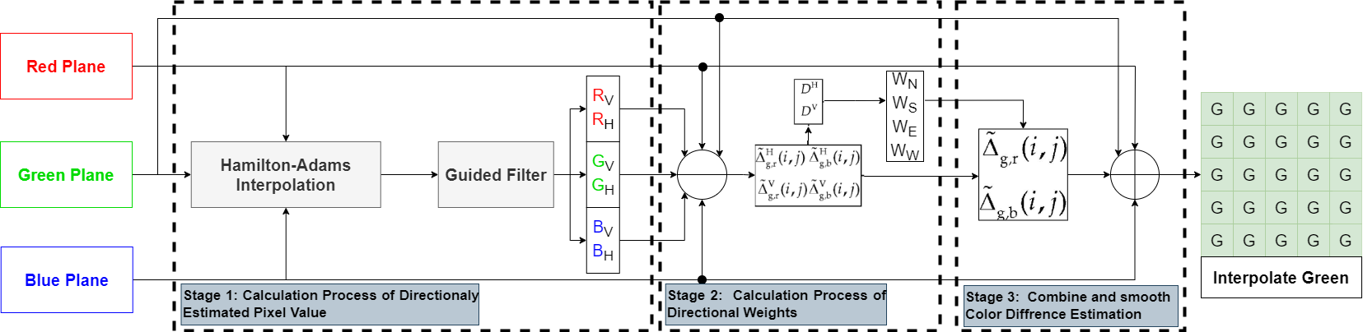
Green Channel Interpolation
The interpolation processes of the missing G pixel values can be divided into three steps
Stage 1: Calculate the Directionally (Horizontal/Vertical) Estimated Pixel Value of R, G and B (Rv, Rh, Gv, Gh, Bv, Bh) based on Horizontal/Vertical Interpolation and the Guided Filter.
Stage 2: The horizontal and vertical Color Difference Estimations will be calculated, and then it generate the Absolute Color Difference Gradients and Directional (north-south/east-west) Weights.
Stage 3: The Directional (Horizontal/Vertical) Color Difference Estimations are combined and smoothed by using Directional (north-south/east-west) Weight . The G pixel values at the location of R and B pixels are generated by adding ﬁnal color difference to the observed R or B pixel values.
The outline interpolation process of the missing Green pixel

Slide 7
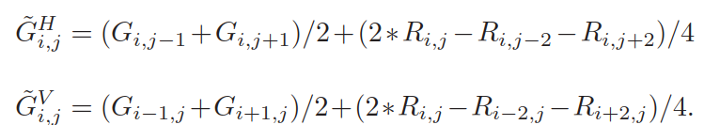
Hamilton and Adam’s Interpolation
Horizontal/Vertical Green channel estimations at Red location are calculated (where the sufﬁx (i, j) represents a target pixel) as
Horizontal /Vertical Red channel estimations at Green location are calculated as
Estimations with Blue pixels are calculated in the same manner, simply by replacing Red with Blue in the formulas above
Notes:
Hamilton and Adam’s Interpolation is using to estimate green values at red or blue pixel locations and versca

Slide 8
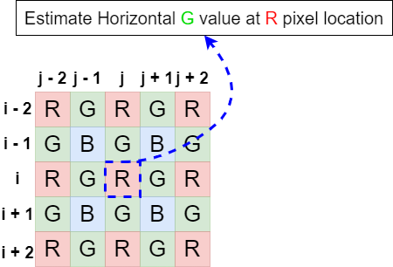
Hamilton and Adam’s Interpolation
Horizontal/Vertical Green channel estimations at Red location are calculated as

Slide 9
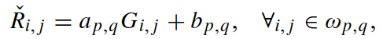
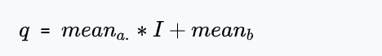
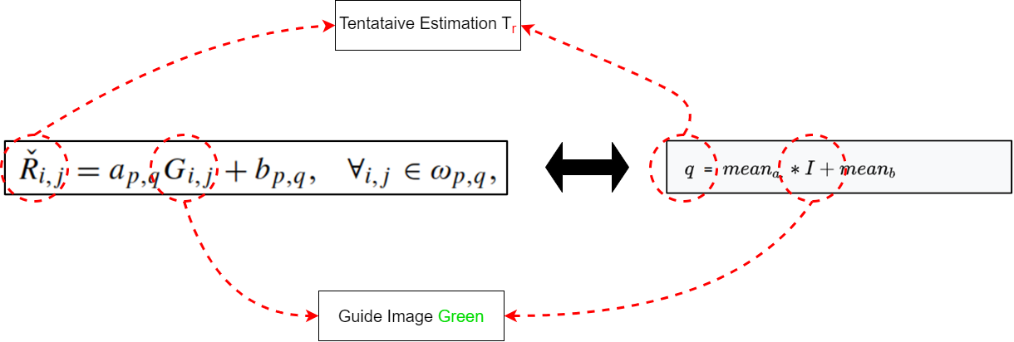
Guided Filter
A guided filter is an edge-preserving smoothing image filter.
The Tentative Estimation of Red with the guide image Green can show as the formula below (Tentative Estimate of Blue, and Green are conduct the same manner)
Notes:
We generate such accurate tentative estimates by using the guided ﬁlter

Slide 10
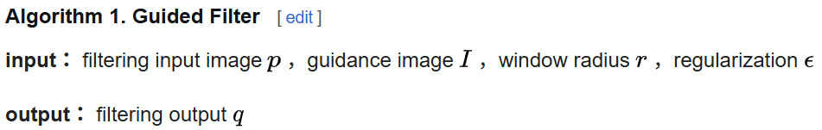
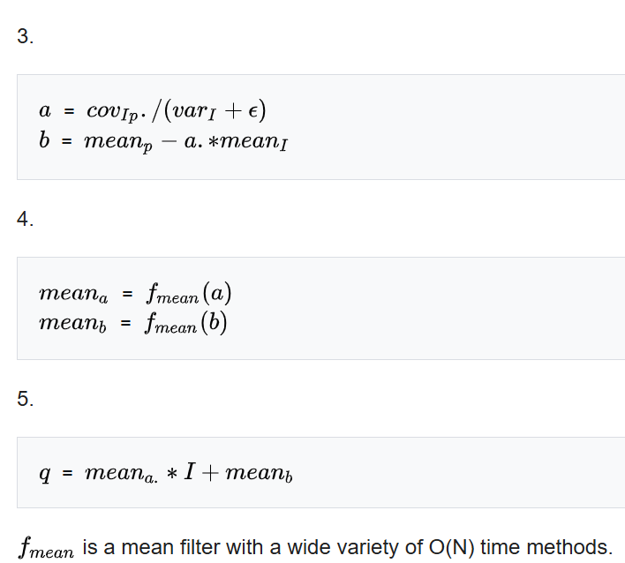
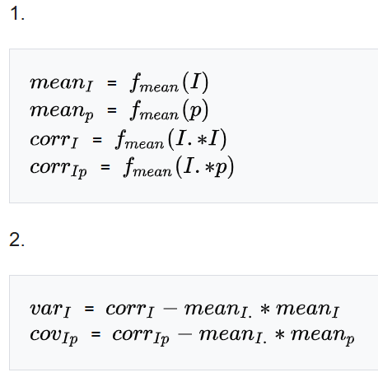
Guided Filter

Slide 11
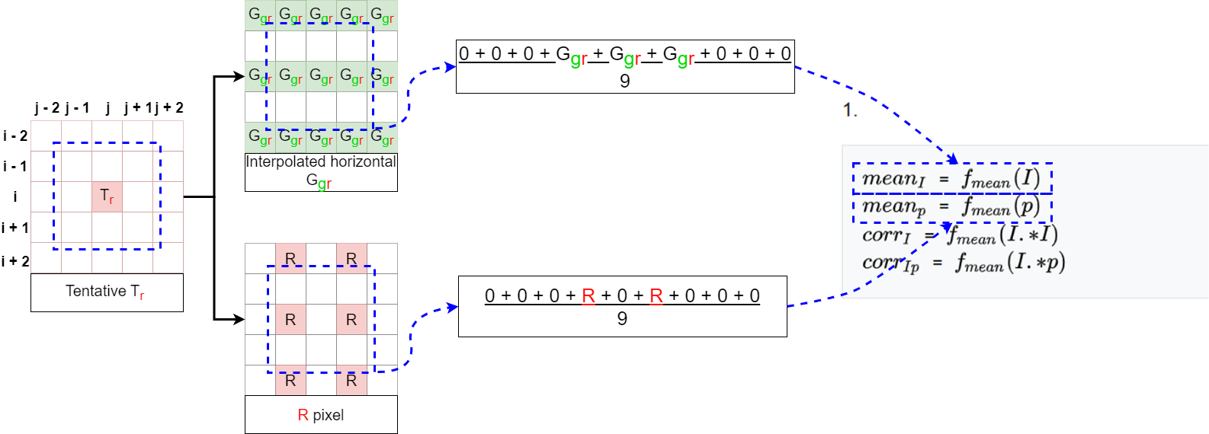
Mean Filter
fmean​ is a mean filter (also called a box filter) that can be implemented using a wide variety of algorithms that run in linear time
It works by replacing each pixel in an image with the average of its neighboring pixels in a fixed-size window.
Notes:
A tentative estimate is a first guess. It is not the final or exact result. It is used to start the process, and then improved later with more accurate methods.

Slide 12
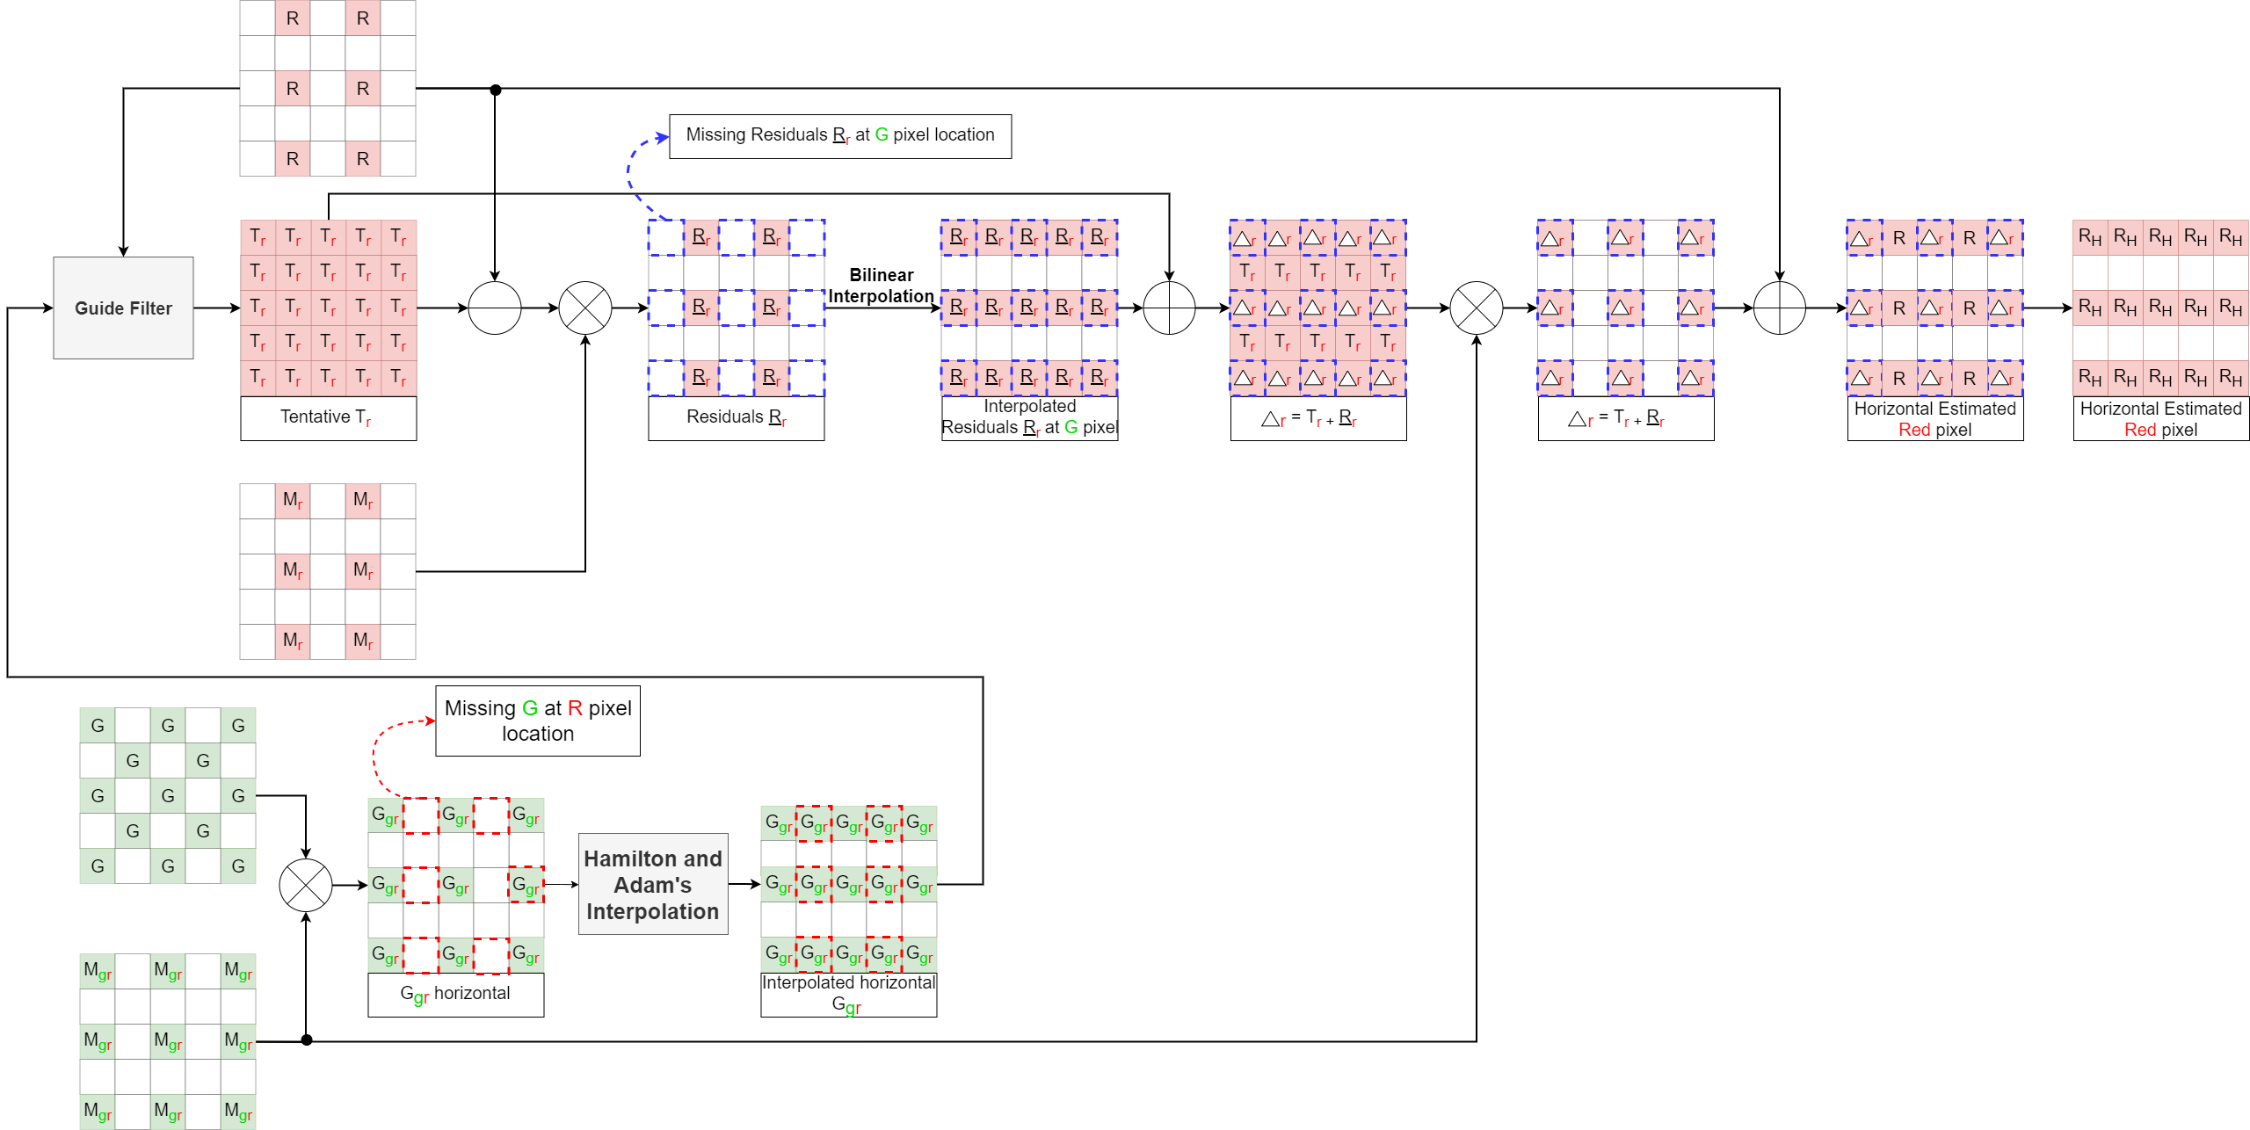
Green Channel Interpolation – Stage 1
The Rh horizontal Estimated Red pixel
Notes:
A tentative estimate is a first guess. It is not the final or exact result. It is used to start the process, and then improved later with more accurate methods.

Slide 13
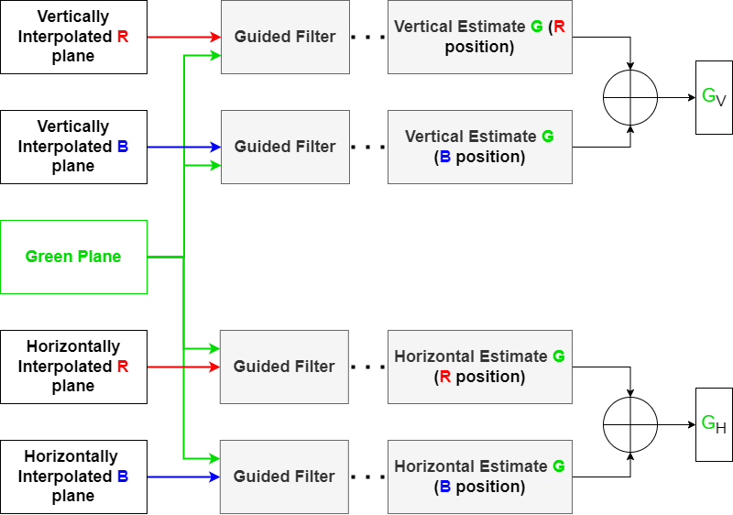
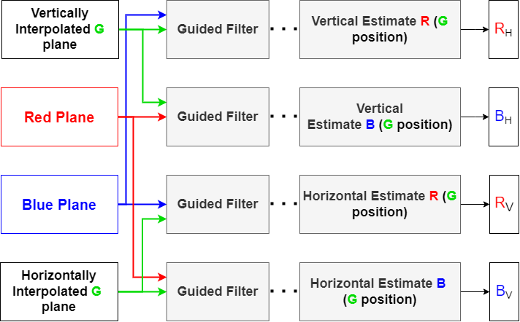
Green Channel Interpolation – Stage 1
The Horizontal/Vertical Red, Blue, and Green Estimated Pixel Value

Slide 14
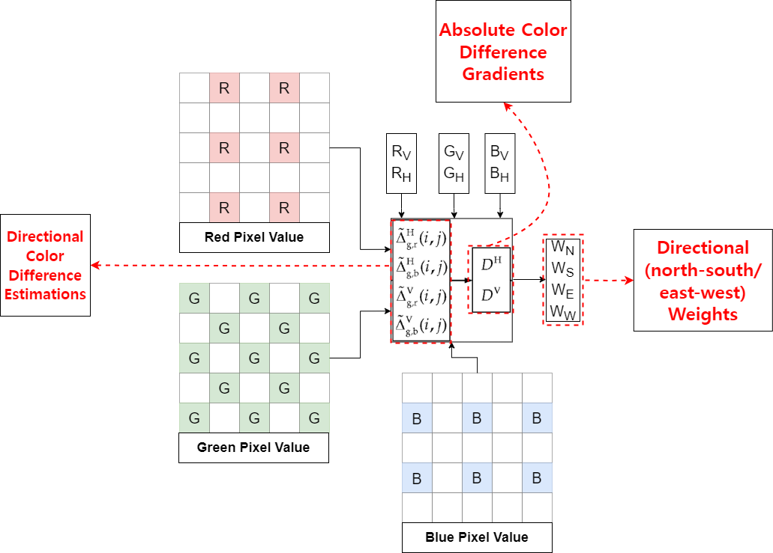
Green Channel Interpolation – Stage 2
In this section, we use the Directional Color Difference Estimations and the Absolute Color Difference Gradients to calculate the Directional (north-south/east-west) Weights.
Stage 2: The Calculation Directional Weights
Notes:
A tentative estimate is a first guess. It is not the final or exact result. It is used to start the process, and then improved later with more accurate methods.

Slide 15
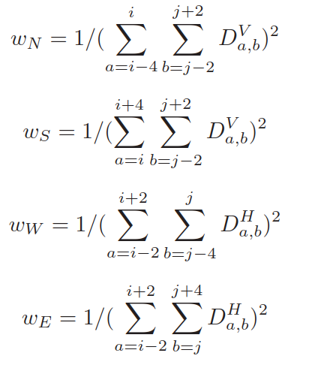
Green Channel Interpolation – Stage 2
The Directional Color Difference Estimations can be calculated by the formula below, where is the horizontal Color Difference Estimation between G and R image.
After using the Directional Color Difference Estimations to calculate the Absolute Color Difference Gradients. The Absolute Color Difference Gradients at pixel coordinates (i, j) is given below. ( is the horizontal color difference estimation in (i, j)).
The Directional (north-south/east-west) Weights are calculated by

Slide 16
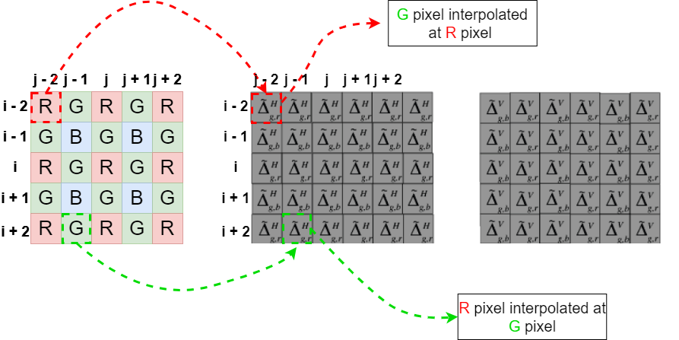
Green Channel Interpolation – Stage 2
The Directional Color Difference Estimations can be calculated by the formula below, where is the horizontal Color Difference Estimation between G and R image.

Slide 17
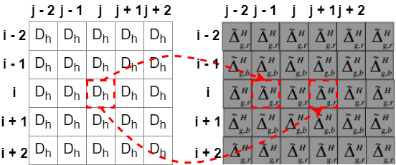
Green Channel Interpolation – Stage 2
After using the Directional Color Difference Estimations to calculate the Absolute Color Difference Gradients. The Absolute Color Difference Gradients at pixel coordinates (i, j) is given below. ( is the horizontal color difference estimation in (i, j)).
Horizontal Color Difference Estimation
Notes:
These gradients tell us how fast the color difference is changing in each direction. ​
Large gradients indicate edge regions and suggest unreliable directions.​
Small gradients indicate smooth regions, which are more reliable for interpolation.​

Slide 18
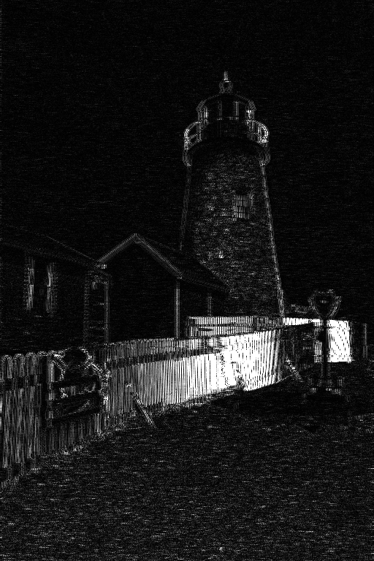
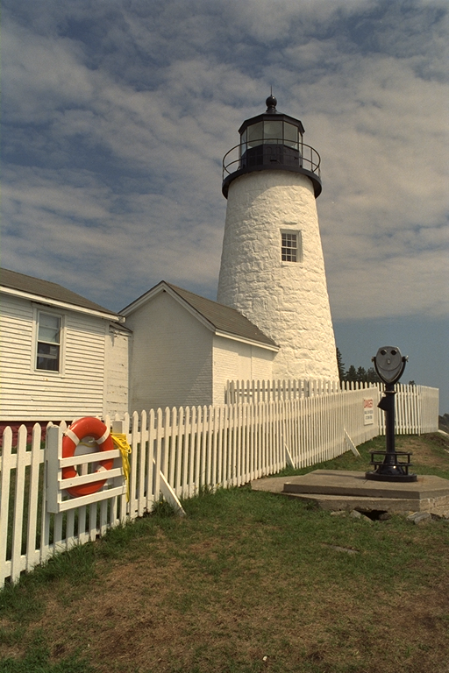
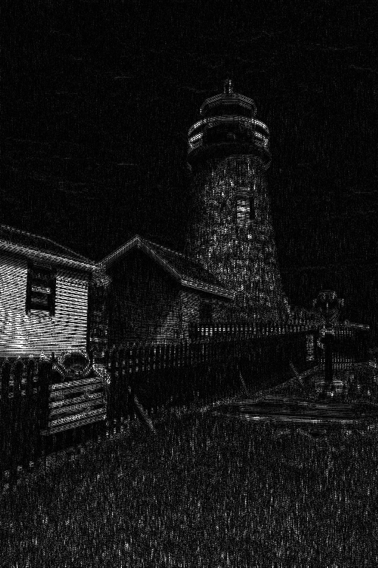
Green Channel Interpolation – Stage 2
Original Image
3D Horizontal Gradient
3D Vertical Gradient
Notes:
These gradients tell us how fast the color difference is changing in each direction. ​
Large gradients indicate edge regions and suggest unreliable directions.​
Small gradients indicate smooth regions, which are more reliable for interpolation.​

Slide 19
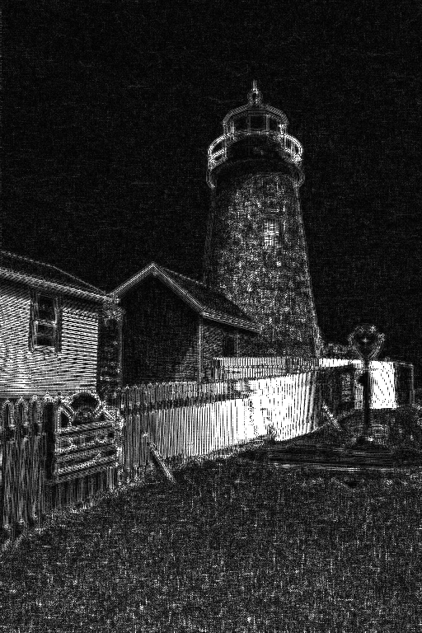
Green Channel Interpolation – Stage 2
Original Image
3D Horizontal + Vertical Gradient
Notes:
These gradients tell us how fast the color difference is changing in each direction. ​
Large gradients indicate edge regions and suggest unreliable directions.​
Small gradients indicate smooth regions, which are more reliable for interpolation.​

Slide 20
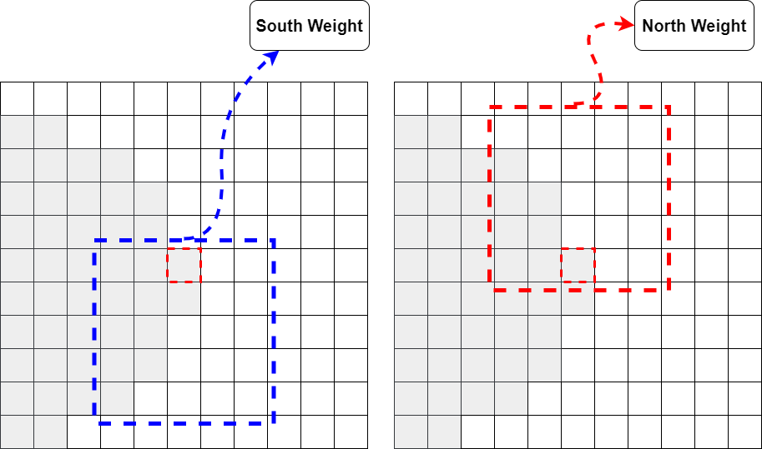
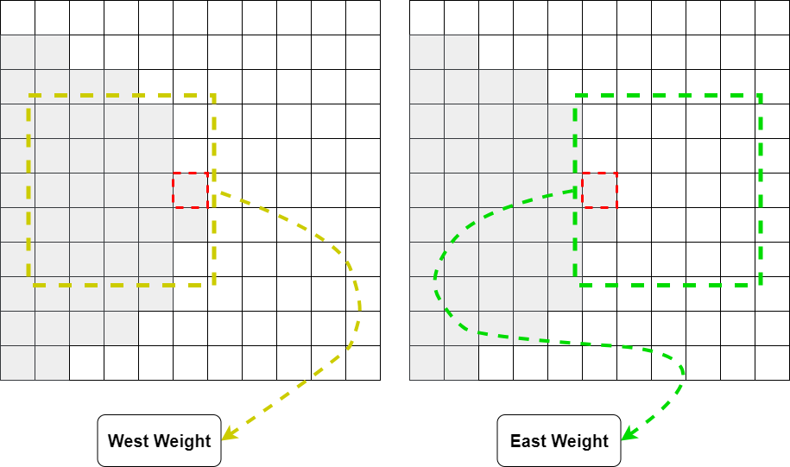
Green Channel Interpolation – Stage 2
The Directional (north-south/east-west) Weights are calculated by
The purpose of computing directional gradients is to estimate how "smooth" or "sharp" each direction (North, South, East, West) is around the pixel we want to interpolate.
Low gradient = smooth area → good direction for interpolation → High weight.
High gradient = edge or sharp change → bad direction for interpolation → Low weight.
Notes:
These gradients tell us how fast the color difference is changing in each direction. ​
Large gradients indicate edge regions and suggest unreliable directions.​
Small gradients indicate smooth regions, which are more reliable for interpolation.​
f = [11111]/5, is used for smoothing the directional color differences

Slide 21
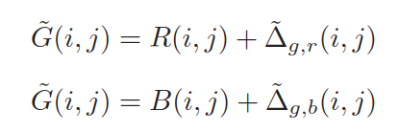
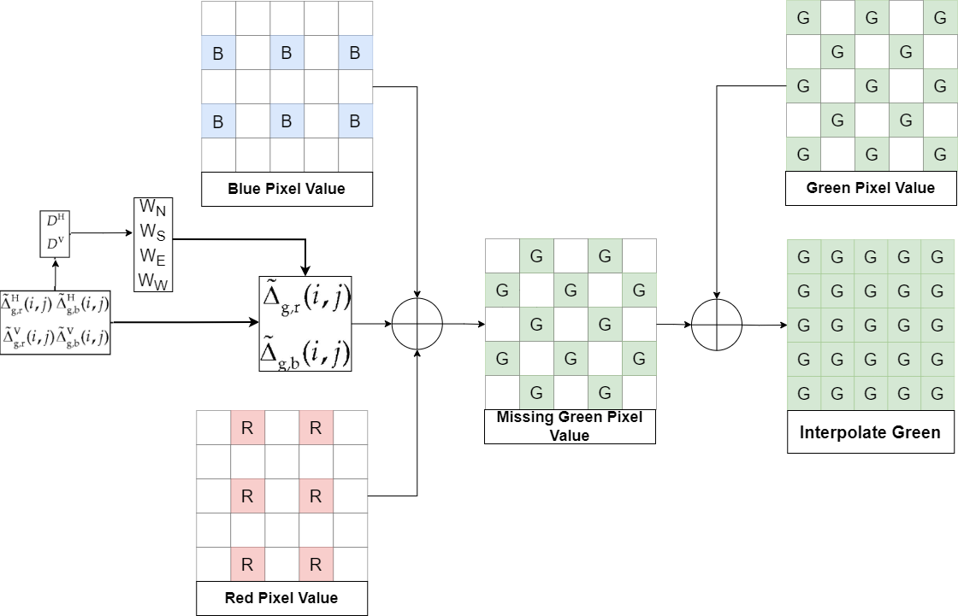
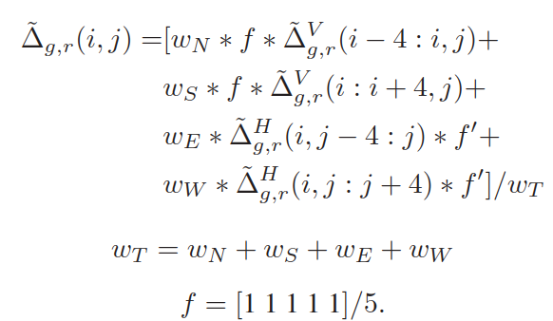
Green Channel Interpolation – Stage 3
After getting the Weights and the Directional Color Difference Estimations at each pixel after Step 2. Then, the Directional Color Difference Estimations are combined and smoothed by Equation below
Once the color difference has been estimated, it is added to the available target pixel to compute the estimated green (G) pixel value.
Combined and smoothed directional color difference estimations using Directional Weights (Wn, Ws, Ww, We)
Stage 3: The Calculation Process of Estimated Pixel Values
Notes:
After determining all weights and gradients, we use them to compute a refined green channel, which serves as guidance for red and blue channel interpolation.

Slide 22
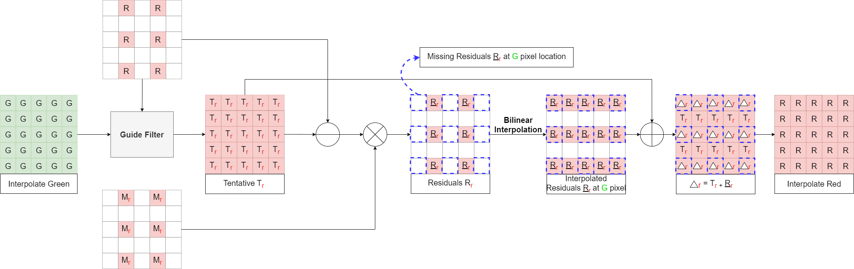
Red/Blue Channel Interpolation
After the missing G pixel are interpolated, the RI algorithm uses the residual interpolation for estimating the R and B pixel values. The Blue Channel Interpolation is conducted the same manners.
Red Channel Interpolation
Notes:
Once the green channel is reconstructed, we apply the residual interpolation method to the red and blue channels using the green guide. The process is symmetric for both channels.

Slide 23
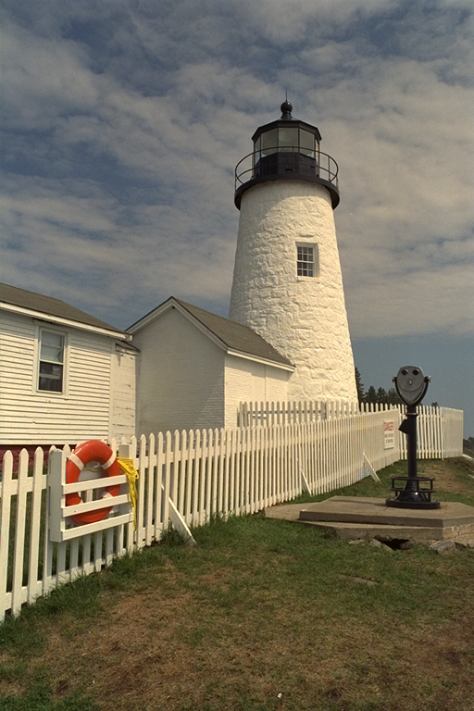
Result of Residual Interpolation
Kodak | R-PNSR | G-PNSR | B-PNSR | CPSNR | SSIM | Time(s)
1 | 36.13 | 41.18 | 38.58 | 38.16 | 0.9864 | 0.367227
2 | 35.97 | 44.58 | 42.15 | 39.35 | 0.9704 | 0.374257
3 | 39.92 | 45.42 | 40.65 | 41.41 | 0.9863 | 0.377411
4 | 36.72 | 44.03 | 42.43 | 39.86 | 0.9789 | 0.444639
5 | 36.5 | 40.94 | 35.93 | 37.29 | 0.9871 | 0.389759
6 | 39.88 | 43.24 | 39.36 | 40.52 | 0.9886 | 0.389247
7 | 40.35 | 45.16 | 39.64 | 41.13 | 0.9877 | 0.389357
8 | 34.63 | 39.58 | 35.26 | 36.01 | 0.9855 | 0.395739
9 | 41.05 | 44.95 | 39.77 | 41.43 | 0.9816 | 0.429124
10 | 40.34 | 44.87 | 40.76 | 41.57 | 0.9845 | 0.460273
11 | 37.23 | 42.78 | 40.01 | 39.43 | 0.9858 | 0.427356
12 | 41.15 | 46.51 | 41.99 | 42.67 | 0.9858 | 0.398437
13 | 35.56 | 36.77 | 33.99 | 35.29 | 0.983 | 0.400459
14 | 33.74 | 40.44 | 35.76 | 35.86 | 0.9822 | 0.401612
15 | 35.52 | 42.55 | 40.34 | 38.45 | 0.9728 | 0.386896
16 | 43.22 | 46.41 | 42.44 | 43.71 | 0.9899 | 0.402992
17 | 41.36 | 43.23 | 39.97 | 41.32 | 0.9876 | 0.446885
18 | 35.82 | 39 | 36.48 | 36.9 | 0.9788 | 0.434629
19 | 39.31 | 42.98 | 39.46 | 40.29 | 0.984 | 0.445677
20 | 41.65 | 44.03 | 38.8 | 40.97 | 0.9765 | 0.395059
21 | 39.11 | 41.98 | 37.83 | 39.32 | 0.9813 | 0.408341
22 | 37.59 | 41.06 | 36.72 | 38.09 | 0.9745 | 0.406965
23 | 39.83 | 45.68 | 40.44 | 41.32 | 0.9808 | 0.450228
24 | 35.67 | 37.7 | 33.6 | 35.34 | 0.9846 | 0.424849
Average | 38.26 | 42.71 | 38.85 | 39.4 | 0.9827 | 0.410309
Kodim19 Original Image
Kodim19 Demosaic Image

Slide 24

Result of MLRI
Kodak | R-PNSR | G-PNSR | B-PNSR | CPSNR | SSIM | Time(s)
1 | 37.92 | 41.29 | 39.18 | 39.25 | 0.9885 | 0.41796
2 | 36.44 | 44.73 | 42.55 | 39.77 | 0.972 | 0.41357
3 | 40.63 | 45.73 | 41.4 | 42.08 | 0.987 | 0.43530
4 | 36.09 | 44.18 | 42.81 | 39.5 | 0.9772 | 0.49151
5 | 36.3 | 40.72 | 36.07 | 37.24 | 0.9872 | 0.45115
6 | 40.1 | 43.12 | 39.37 | 40.59 | 0.989 | 0.43650
7 | 40.64 | 45.23 | 39.74 | 41.3 | 0.9881 | 0.43530
8 | 35.11 | 39.71 | 35.99 | 36.53 | 0.9866 | 0.43050
9 | 41.1 | 44.98 | 41.1 | 42.05 | 0.9818 | 0.47235
10 | 40.1 | 44.9 | 41.05 | 41.58 | 0.9844 | 0.51485
11 | 38 | 42.89 | 40.36 | 39.97 | 0.9869 | 0.45075
12 | 41.52 | 46.62 | 42.74 | 43.14 | 0.9865 | 0.44342
13 | 35.96 | 36.94 | 34.09 | 35.5 | 0.9836 | 0.45704
14 | 33.75 | 40.63 | 36 | 35.97 | 0.9836 | 0.44831
15 | 35.45 | 42.48 | 40.62 | 38.45 | 0.9733 | 0.45300
16 | 43.75 | 46.48 | 42.82 | 44.09 | 0.9903 | 0.49211
17 | 41.25 | 43.22 | 40.16 | 41.37 | 0.9875 | 0.48655
18 | 35.63 | 38.88 | 36.75 | 36.88 | 0.9794 | 0.47009
19 | 39.82 | 43.05 | 40.01 | 40.73 | 0.9842 | 0.51011
20 | 41.76 | 44.12 | 39.07 | 41.17 | 0.9779 | 0.45326
21 | 39.79 | 42.25 | 38.21 | 39.78 | 0.9821 | 0.44544
22 | 37.47 | 40.97 | 36.81 | 38.07 | 0.975 | 0.45957
23 | 40.42 | 46.03 | 41.43 | 42.03 | 0.9824 | 0.48850
24 | 35.36 | 37.59 | 33.53 | 35.18 | 0.9849 | 0.53477
Average | 38.52 | 42.78 | 39.24 | 39.68 | 0.9833 | 0.46216
Kodim19 Original Image
Kodim19 Demosaic Image

Slide 25
Evaluation of Residual Interpolation
I have conducted test on company laptop with CPU: i5-1335U @ 1.30 GHz (Boost 3.6 GHz), 10 threads, RAM: 16GB, OS: Windows 11 Pro.
The mean CPSNR of 39.4 dB and a high structural similarity index (SSIM) of 0.9826 for total 24 images on Kodak dataset with the average of time is 0.41s.
Last week, I have trying to applying Minimized-Laplacian Residual Interpolation (MLRI) improved the CPSNR to 39.68 dB and SSIM to 0.9833, it still did not meet the 40 dB target.
Next week, I plan to begin implementing a bit-accurate model for Residual Interpolation (RI) to further improve the results.

Slide 26

Thank you

Slide 27
Improve Residual Interpolation for Color Image Demosaicking
09-07-2024 Dinh Hoang Luan
Notes:
Good morning/afternoon everyone.
My name is Dinh Hoang Luan, and today I’ll be presenting a demosaicking technique called Residual Interpolation (RI)

Slide 28
Red/Blue Channel Interpolation - RI
In the paper, the author only using the Tentative value and Residual value from Red pixel and interpolate Green to find the missing Red pixel at Green and Blue location. Consequently, the actual Green pixel at those locations (present in the original Bayer pattern) are not utilized.
Furthermore, interpolate missing Red pixel at Green and Blue location are the same
This limitation can lead to less accurate Red value reconstruction at Green and Blue locations, as potentially valuable local color information is ignored.
Red Channel Interpolation
Notes:
Once the green channel is reconstructed, we apply the residual interpolation method to the red and blue channels using the green guide. The process is symmetric for both channels.

Slide 29
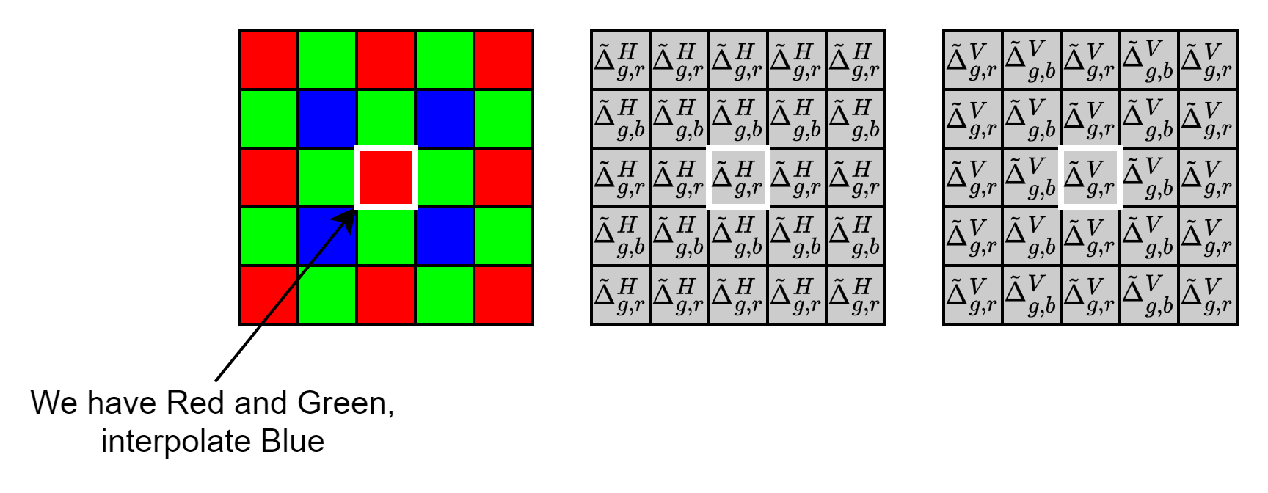
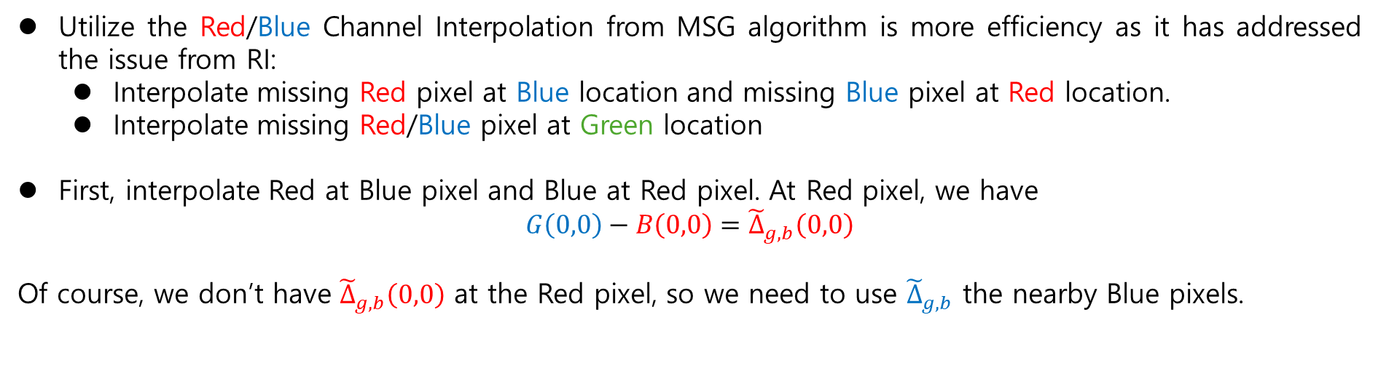
Red/Blue Channel Interpolation - MSG
Utilize the Red/Blue Channel Interpolation from MSG algorithm is more efficiency as it has addressed the issue from RI:
Interpolate missing Red pixel at Blue location and missing Blue pixel at Red location.
Interpolate missing Red/Blue pixel at Green location
First, interpolate Red at Blue pixel and Blue at Red pixel. At Red pixel, we have
$$G\left(0,0\right)−B\left(0,0\right)={\tilde{Δ}}_{g,b}\left(0,0\right)$$
Of course, we don’t have ${\tilde{Δ}}_{g,b}\left(0,0\right)$ at the Red pixel, so we need to use ${\tilde{Δ}}_{g,b}$ the nearby Blue pixels.
Notes:
Once the green channel is reconstructed, we apply the residual interpolation method to the red and blue channels using the green guide. The process is symmetric for both channels.

Slide 30
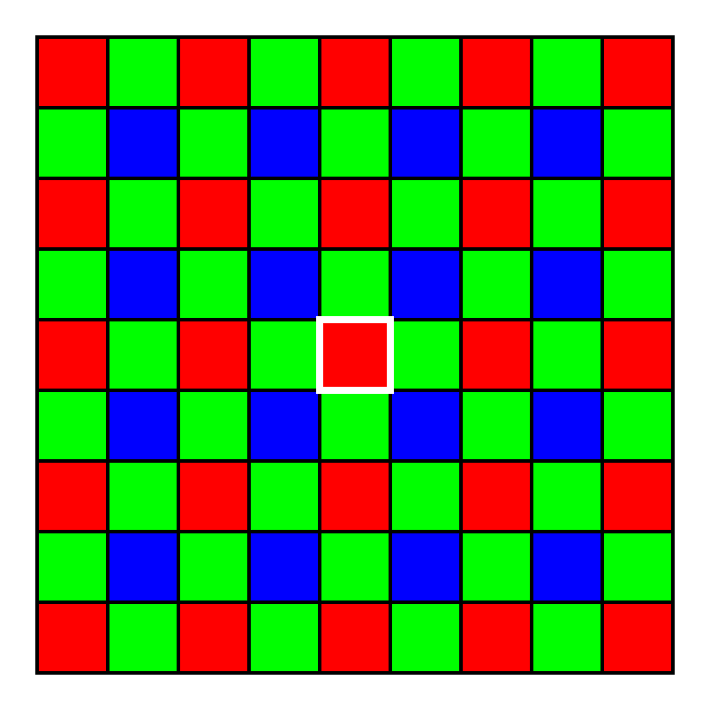
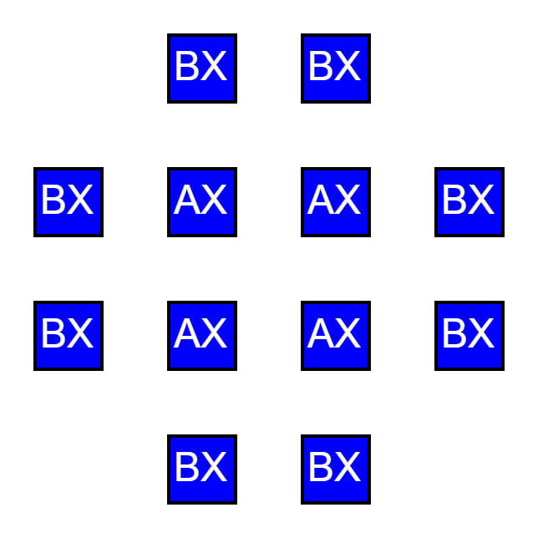
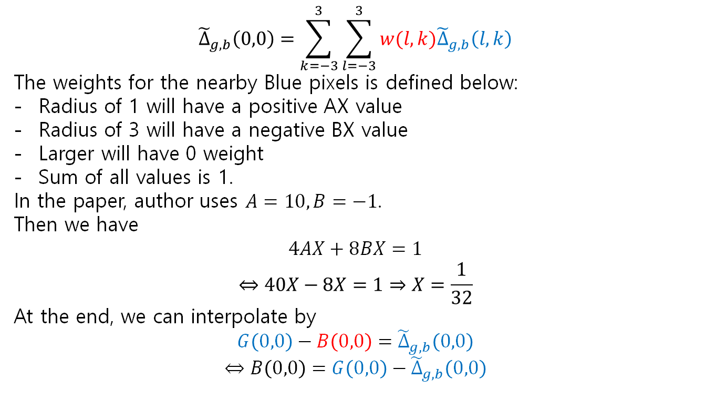
Red/Blue Interpolation at Blue/Red Location
$${\tilde{Δ}}_{g,b}\left(0,0\right)=\sum_{k=−3}^{3}{\sum_{l=−3}^{3}{w(l,k){\tilde{Δ}}_{g,b}\left(l,k\right)}}$$
The weights for the nearby Blue pixels is defined below:
Radius of 1 will have a positive AX value
Radius of 3 will have a negative BX value
Larger will have 0 weight
Sum of all values is 1.
In the paper, author uses $A=10, B=−1$.
Then we have
$$4AX+8BX=1$$
$$⇔40X−8X=1⇒X=\frac{1}{32}$$
At the end, we can interpolate by
$$G\left(0,0\right)−B\left(0,0\right)={\tilde{Δ}}_{g,b}\left(0,0\right)$$
$$⇔B\left(0,0\right)=G\left(0,0\right)−{\tilde{Δ}}_{g,b}\left(0,0\right)$$

Slide 31
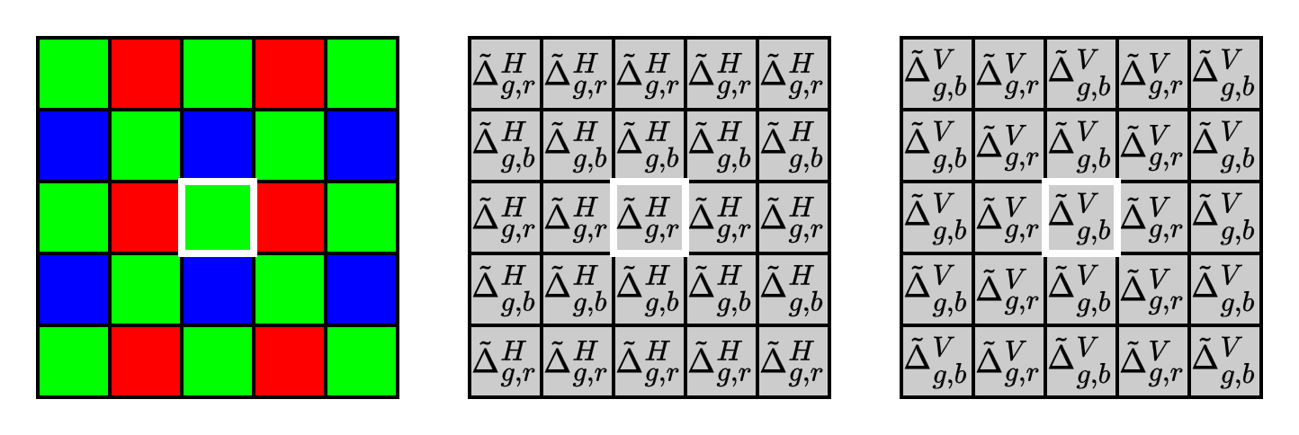
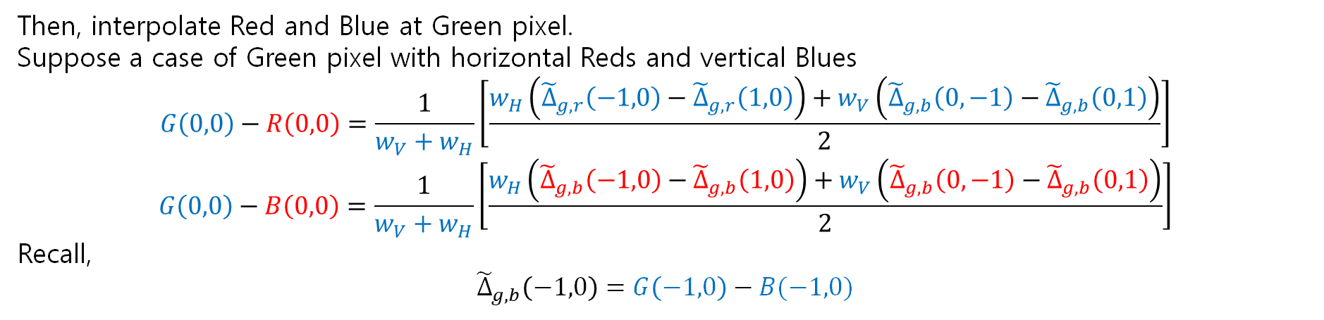
Red and Blue Interpolation at Green Location
Then, interpolate Red and Blue at Green pixel.
Suppose a case of Green pixel with horizontal Reds and vertical Blues
$$G\left(0,0\right)−R\left(0,0\right)=\frac{1}{w_{V}+w_{H}}\left[\frac{w_{H}\left({\tilde{Δ}}_{g,r}\left(−1,0\right)−{\tilde{Δ}}_{g,r}\left(1,0\right)\right)+w_{V}\left({\tilde{Δ}}_{g,b}\left(0,−1\right)−{\tilde{Δ}}_{g,b}\left(0,1\right)\right)}{2}\right]$$
$$G\left(0,0\right)−B\left(0,0\right)=\frac{1}{w_{V}+w_{H}}\left[\frac{w_{H}\left({\tilde{Δ}}_{g,b}\left(−1,0\right)−{\tilde{Δ}}_{g,b}\left(1,0\right)\right)+w_{V}\left({\tilde{Δ}}_{g,b}\left(0,−1\right)−{\tilde{Δ}}_{g,b}\left(0,1\right)\right)}{2}\right]$$
Recall,
$${\tilde{Δ}}_{g,b}\left(−1,0\right)=G\left(−1,0\right)−B(−1,0)$$

Slide 32
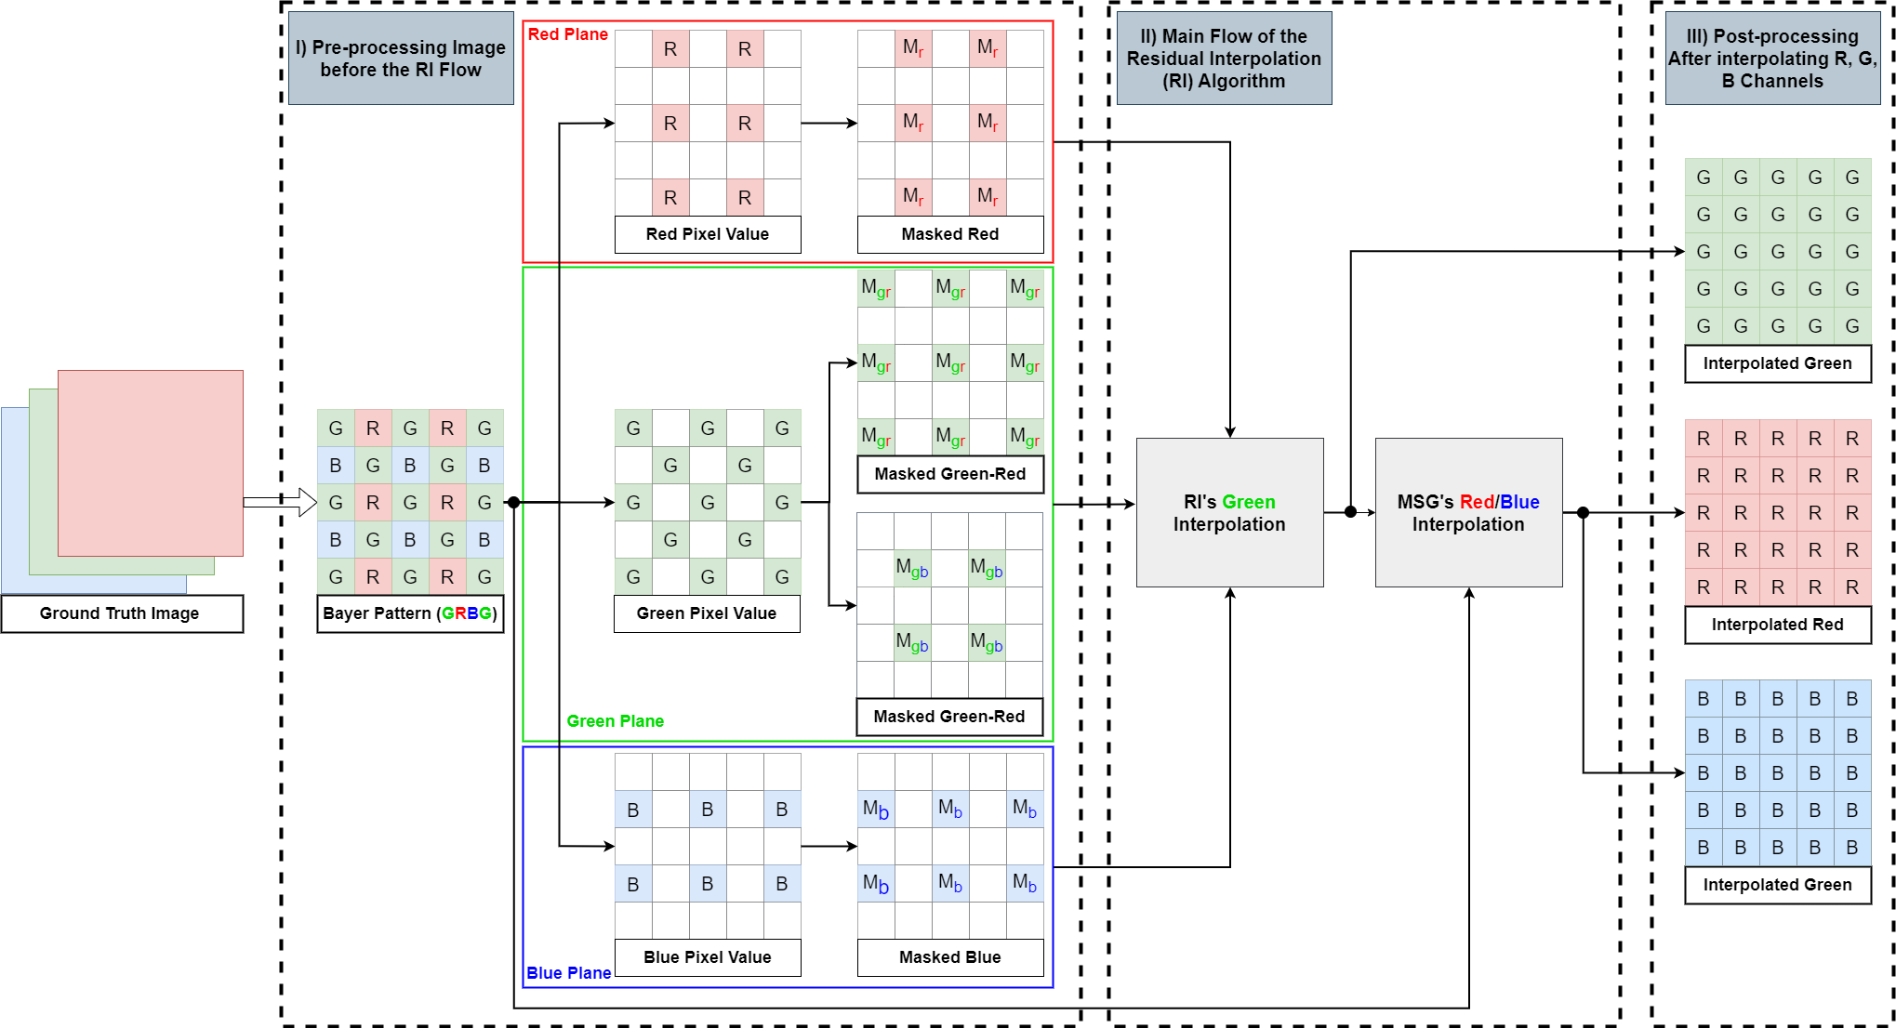
Improvement
Improvement of Residual Interpolation by using Red and Blue channel interpolation from MSG

Slide 33

Result of Residual Interpolation Improvement
Kodim | FC% (T=5) | CPSNR | SSIM
1 | 14.16194 | 39.81 | 0.9902
2 | 8.85951 | 41.55 | 0.9796
3 | 4.13132 | 43.18 | 0.9891
4 | 11.90898 | 40.49 | 0.9813
5 | 15.74682 | 38.1 | 0.9897
6 | 8.28222 | 41.19 | 0.9902
7 | 6.03739 | 42.65 | 0.9903
8 | 20.98796 | 37.19 | 0.9885
9 | 3.27911 | 43.57 | 0.9858
10 | 3.76511 | 42.78 | 0.9872
11 | 8.36309 | 40.88 | 0.9895
12 | 3.59777 | 44.09 | 0.9885
13 | 29.31163 | 35.57 | 0.9848
14 | 12.42345 | 37.03 | 0.9862
15 | 12.20271 | 39.68 | 0.9777
16 | 3.35795 | 44.63 | 0.9912
17 | 3.99246 | 41.97 | 0.9894
18 | 17.72436 | 37.54 | 0.9822
19 | 7.12865 | 41.83 | 0.9868
20 | 7.80945 | 41.77 | 0.978
21 | 10.85714 | 40 | 0.9839
22 | 14.33411 | 38.68 | 0.9771
23 | 4.94995 | 43.36 | 0.9853
24 | 14.84273 | 35.26 | 0.9867
Average | 10.33566 | 40.53333 | 0.9858
Kodim19 RI
Kodim19 RI Improvement

Slide 34
Result of Residual Interpolation Improvement
Kodim | FC% (T=5) | CPSNR | SSIM
1 | 14.16194 | 39.81 | 0.9902
2 | 8.85951 | 41.55 | 0.9796
3 | 4.13132 | 43.18 | 0.9891
4 | 11.90898 | 40.49 | 0.9813
5 | 15.74682 | 38.1 | 0.9897
6 | 8.28222 | 41.19 | 0.9902
7 | 6.03739 | 42.65 | 0.9903
8 | 20.98796 | 37.19 | 0.9885
9 | 3.27911 | 43.57 | 0.9858
10 | 3.76511 | 42.78 | 0.9872
11 | 8.36309 | 40.88 | 0.9895
12 | 3.59777 | 44.09 | 0.9885
13 | 29.31163 | 35.57 | 0.9848
14 | 12.42345 | 37.03 | 0.9862
15 | 12.20271 | 39.68 | 0.9777
16 | 3.35795 | 44.63 | 0.9912
17 | 3.99246 | 41.97 | 0.9894
18 | 17.72436 | 37.54 | 0.9822
19 | 7.12865 | 41.83 | 0.9868
20 | 7.80945 | 41.77 | 0.978
21 | 10.85714 | 40 | 0.9839
22 | 14.33411 | 38.68 | 0.9771
23 | 4.94995 | 43.36 | 0.9853
24 | 14.84273 | 35.26 | 0.9867
Average | 10.33566 | 40.53333 | 0.9858
Kodim19 RI
Kodim19 RI Improvement

Slide 35
Four-Direction Residual Interpolation
for Demosaicking
14-07-2024 Dinh Hoang Luan
Notes:
The proposed algorithm is based on the RI [18] and MLRI [19] algorithms.
The guided ﬁltering technique is exploited to calculate the residual data. The guided ﬁlter is a powerful edge-preserving ﬁlter

Slide 36
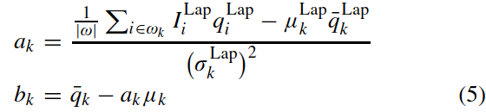
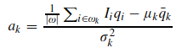
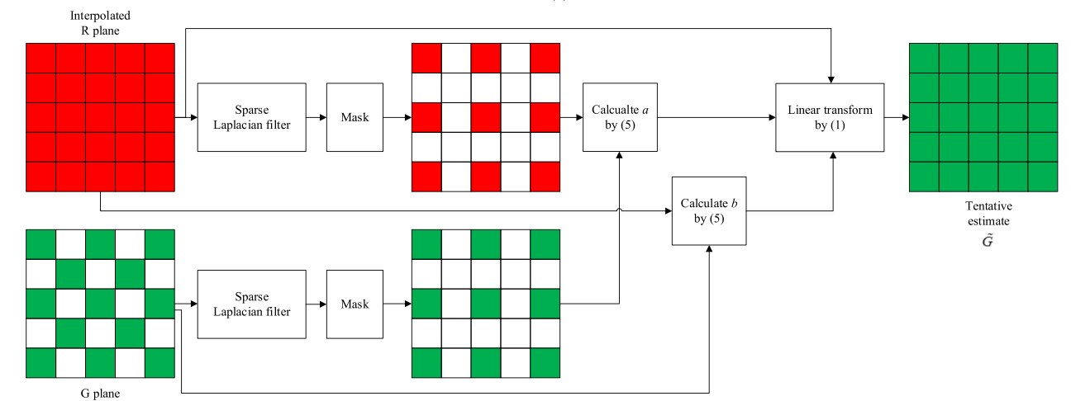
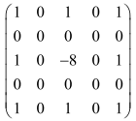
Green Interpolation – Tentative Pixel
(1)
(3)
(5)
The outline guided Upsampling process of FDRI
Notes:
- To interpolate R pixels at G pixel position, two-tap bilinear ﬁlter ([1/2 1/2]) is used.
1) input image qi (Green from bayer)
2) guidance image Ii (Interpolated Red).
3) input image qi (Lap) (Green from bayer multiply with Laplacian filter)
4) guidance image Ii(Lap) (Interpolated Red multiply with Laplacian filter).
5) |ω| is the number of pixels in ωk
6) μkLap and (σkLap)2 are the mean and variance of ILap in ωk
7) ¯kLap is the mean of qLap in ωk .

Slide 37
Green Interpolation – Guided Filter

Slide 38
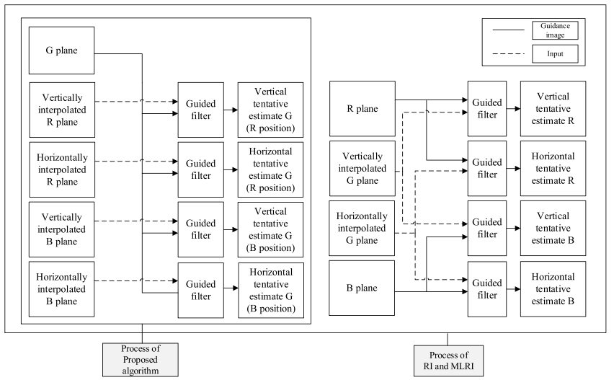
Green Interpolation – Tentative Pixel
Guided ﬁltering process required for G plan interpolation of the proposed algorithm, RI, and MLRI.
Notes:
The proposed algorithm requires only a tentative G plane, whereas RI and MLRI require tentative G, R, and B planes for the G channel interpolation.
As the proposed algorithm interpolates the G plane using an estimated G and originally captured G plane

Slide 39
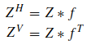
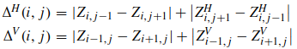
Green Interpolation - The directional gradients
The horizontally and vertically interpolated Bayer planes as
The horizontally and vertically interpolated Bayer planes as

Slide 40
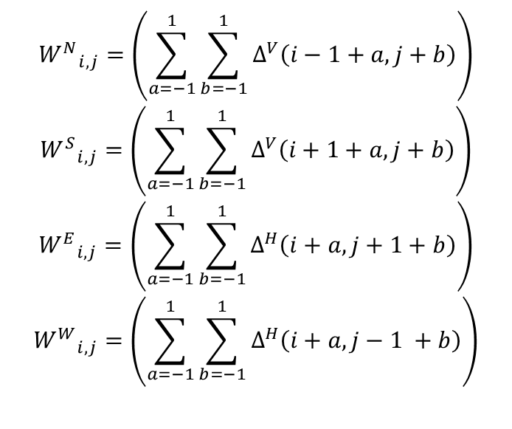
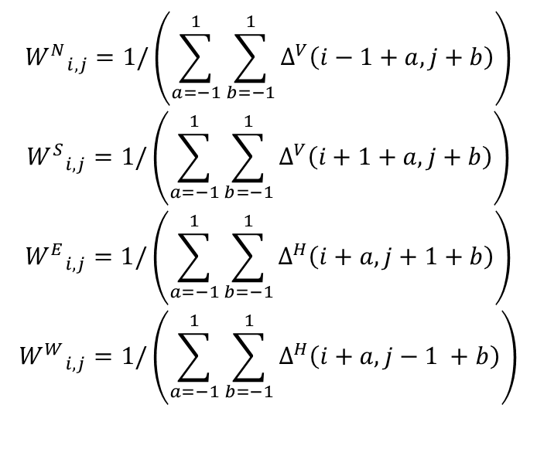
Green Interpolation - The directional weights
The four directional weights are calculated as
$${W^{N}}_{i,j}=\left(\sum_{a=−1}^{1}{\sum_{b=−1}^{1}{Δ^{V}\left(i−1+a,j+b\right)}}\right)$$
$${W^{S}}_{i,j}=\left(\sum_{a=−1}^{1}{\sum_{b=−1}^{1}{Δ^{V}\left(i+1+a,j+b\right)}}\right)$$
$${W^{E}}_{i,j}=\left(\sum_{a=−1}^{1}{\sum_{b=−1}^{1}{Δ^{H}\left(i+a,j+1+b\right)}}\right)$$
$${W^{W}}_{i,j}=\left(\sum_{a=−1}^{1}{\sum_{b=−1}^{1}{Δ^{H}\left(i+a,j−1 +b\right)}}\right)$$
$${W^{N}}_{i,j}=1/\left(\sum_{a=−1}^{1}{\sum_{b=−1}^{1}{Δ^{V}\left(i−1+a,j+b\right)}}\right)$$
$${W^{S}}_{i,j}=1/\left(\sum_{a=−1}^{1}{\sum_{b=−1}^{1}{Δ^{V}\left(i+1+a,j+b\right)}}\right)$$
$${W^{E}}_{i,j}=1/\left(\sum_{a=−1}^{1}{\sum_{b=−1}^{1}{Δ^{H}\left(i+a,j+1+b\right)}}\right)$$
$${W^{W}}_{i,j}=1/\left(\sum_{a=−1}^{1}{\sum_{b=−1}^{1}{Δ^{H}\left(i+a,j−1 +b\right)}}\right)$$

Slide 41
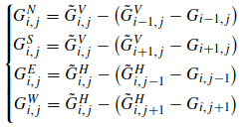
Green Interpolation – Reconstructed G
The directional estimates of G in the north, south, east, and west directions:
The G′ represents the reconstructed G pixel and α is experimentally determined as 0.7
$$G^{′} =α×\left(W_{i,j}^{N}×G_{i,j}^{N}+W_{i,j}^{S}×G_{i,j}^{S}+W_{i,j}^{W}×G_{i,j}^{W}+W_{i,j}^{E}×G_{i,j}^{E}\right)+(1 −α)×\left(W_{i,j}^{N}×G_{i−1,j}+W_{i,j}^{S}×G_{i+1,j}+W_{i,j}^{W}×G_{i,j−1}+W_{i,j}^{E}×G_{i,j+1}\right)$$
$$G^{′} = \frac{α×\left(W_{i,j}^{N}×G_{i,j}^{N}+W_{i,j}^{S}×G_{i,j}^{S}+W_{i,j}^{W}×G_{i,j}^{W}+W_{i,j}^{E}×G_{i,j}^{E}\right)+(1 −α)×\left(W_{i,j}^{N}×G_{i−1,j}+W_{i,j}^{S}×G_{i+1,j}+W_{i,j}^{W}×G_{i,j−1}+W_{i,j}^{E}×G_{i,j+1}\right)}{\left(W_{i,j}^{N}+W_{i,j}^{S}+W_{i,j}^{W}+W_{i,j}^{E}\right)}$$

Slide 42
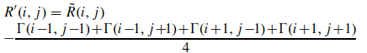


Red/Blue Interpolation
Interpolated Red at Blue location
Interpolated Red at Green location

Slide 43


Result
Kodim19 without modifying
Kodim19 with modifying

Slide 44
Result of Kodak dataset
Kodim19 original
Kodim19 FDRI

Slide 45


Result of Kodak dataset
Kodim01 original
Kodim01 FDRI

Slide 46

Result of MCM dataset
MCM07 original
MCM07 FDRI

Slide 47

Result of MCM dataset
MCM07 original
MCM07 FDRI

Slide 48
Result of Kodak and MCM dataset
MCM dataset
Image | CPSNR (dB) | SSIM
1 | 26.87 | 0.8626
2 | 32.57 | 0.9183
3 | 31.04 | 0.9535
4 | 32.32 | 0.977
5 | 29.98 | 0.9075
6 | 33.33 | 0.9195
7 | 33.73 | 0.9447
8 | 35.41 | 0.9611
9 | 31.94 | 0.9318
10 | 30.64 | 0.9043
11 | 31.97 | 0.9008
12 | 31.53 | 0.9188
13 | 36.64 | 0.93
14 | 34.08 | 0.9067
15 | 30.93 | 0.8847
16 | 31.9 | 0.929
17 | 26.34 | 0.8695
18 | 33.62 | 0.9457
Average | 31.93555556 | 0.920306
Kodak dataset
Image | CPSNR (dB) | SSIM
kodim01 | 33.4 | 0.9567
kodim02 | 33.44 | 0.912
kodim03 | 37.49 | 0.9632
kodim04 | 33.65 | 0.944
kodim05 | 33.41 | 0.9725
kodim06 | 34.79 | 0.966
kodim07 | 38.19 | 0.9793
kodim08 | 31.88 | 0.9653
kodim09 | 39.19 | 0.9706
kodim10 | 39.17 | 0.9754
kodim11 | 35.38 | 0.9661
kodim12 | 39.28 | 0.972
kodim13 | 29.77 | 0.9411
kodim14 | 33.37 | 0.9622
kodim15 | 34.98 | 0.9534
kodim16 | 38.27 | 0.9727
kodim17 | 37.67 | 0.9762
kodim18 | 32.96 | 0.9556
kodim19 | 36 | 0.9637
kodim20 | 37.99 | 0.9626
kodim21 | 35.15 | 0.9668
kodim22 | 35.45 | 0.9563
kodim23 | 38.21 | 0.9644
kodim24 | 32.13 | 0.9705
Average | 35.4675 | 0.962025

Slide 49
Improve Four-Direction Residual Interpolation for Demosaicking using ChatGPT
23-07-2024 Dinh Hoang Luan

Slide 50

Prompt using in ChatGPT

Slide 51


Solution in ChatGPT

Slide 52
Solution in ChatGPT
The G′ represents the reconstructed G pixel and α is experimentally determined as 0.7
$$G^{′} =α×\left(W_{i,j}^{N}×G_{i,j}^{N}+W_{i,j}^{S}×G_{i,j}^{S}+W_{i,j}^{W}×G_{i,j}^{W}+W_{i,j}^{E}×G_{i,j}^{E}\right)+(1 −α)×\left(W_{i,j}^{N}×G_{i−1,j}+W_{i,j}^{S}×G_{i+1,j}+W_{i,j}^{W}×G_{i,j−1}+W_{i,j}^{E}×G_{i,j+1}\right)$$
$$G^{′} = \frac{α×\left(W_{i,j}^{N}×G_{i,j}^{N}+W_{i,j}^{S}×G_{i,j}^{S}+W_{i,j}^{W}×G_{i,j}^{W}+W_{i,j}^{E}×G_{i,j}^{E}\right)+(1 −α)×\left(W_{i,j}^{N}×G_{i−1,j}+W_{i,j}^{S}×G_{i+1,j}+W_{i,j}^{W}×G_{i,j−1}+W_{i,j}^{E}×G_{i,j+1}\right)}{\left(W_{i,j}^{N}+W_{i,j}^{S}+W_{i,j}^{W}+W_{i,j}^{E}\right)}$$

Slide 53

Result
Kodim19 with modifying only reconstructed G
Kodim19 with modifying reconstructed G and Directional Weights

Slide 54
Self-Solution
The four directional weights are calculated as
$${W^{N}}_{i,j}=\left(\sum_{a=−1}^{1}{\sum_{b=−1}^{1}{Δ^{V}\left(i−1+a,j+b\right)}}\right)$$
$${W^{S}}_{i,j}=\left(\sum_{a=−1}^{1}{\sum_{b=−1}^{1}{Δ^{V}\left(i+1+a,j+b\right)}}\right)$$
$${W^{E}}_{i,j}=\left(\sum_{a=−1}^{1}{\sum_{b=−1}^{1}{Δ^{H}\left(i+a,j+1+b\right)}}\right)$$
$${W^{W}}_{i,j}=\left(\sum_{a=−1}^{1}{\sum_{b=−1}^{1}{Δ^{H}\left(i+a,j−1 +b\right)}}\right)$$
$${W^{N}}_{i,j}=1/\left(\sum_{a=−1}^{1}{\sum_{b=−1}^{1}{Δ^{V}\left(i−1+a,j+b\right)}}\right)$$
$${W^{S}}_{i,j}=1/\left(\sum_{a=−1}^{1}{\sum_{b=−1}^{1}{Δ^{V}\left(i+1+a,j+b\right)}}\right)$$
$${W^{E}}_{i,j}=1/\left(\sum_{a=−1}^{1}{\sum_{b=−1}^{1}{Δ^{H}\left(i+a,j+1+b\right)}}\right)$$
$${W^{W}}_{i,j}=1/\left(\sum_{a=−1}^{1}{\sum_{b=−1}^{1}{Δ^{H}\left(i+a,j−1 +b\right)}}\right)$$
The formula from original paper
The formula with modifying

Slide 55

Green Interpolation - The directional gradients

Slide 56



Solution in ChatGPT
RGGB
GBRG
BGGR
GRBG

Slide 57
Summarize Solution from ChatGPT
Step | My code | Correct? | Notes
Initial green estimation | Yes | Yes | Guided filter + conv2
Directional residuals | Yes | Yes | Four directions
Adaptive weighting | Yes | Yes | Based on gradients
Weight normalization | No | No | Should divide by sum of weights
Summary Table

Slide 58
Bayer Image Demosaicking Using Eight-Directional Weights Based on the Gradient of Color Difference
23-07-2024 Dinh Hoang Luan
Notes:
Good morning/afternoon everyone.
My name is Dinh Hoang Luan, and today I’ll be presenting a demosaicking technique called Residual Interpolation (RI)

Slide 59

Green Interpolation
The outline interpolation process of the missing Green pixel

Slide 60





Green Interpolation
The interpolate Green pixel at Red location
The estimated Green pixel in NW, SW, NE, SE directions
The estimated Green pixel in N, S, W, and E directions.
The Green pixels in four diagonals
The weights values in eight directions

Slide 61


Green Interpolation
The gradient information in the NW direction
The gradient information in the N direction
The gradient information of NW directions
The gradient information of N direction

Slide 62



Green Interpolation
The gradient of color difference in the NW direction is obtained as
The color difference in NW direction is deﬁned as
The gradient of the color difference is obtained in the horizontal and vertical directions, respectively
The color difference in the horizontal and vertical directions is shown in

Slide 63
Green Interpolation
The gradient of color difference in the NW direction is obtained as
The color difference in NW direction is deﬁned as
The gradient of the color difference is obtained in the horizontal and vertical directions, respectively
The color difference in the horizontal and vertical directions is shown in

Slide 64


Result of Kodak dataset
Kodim05 RI Improvement
Kodim05 Eight-Directional

Slide 65


Result of Kodak dataset
Kodim03 RI Improvement
Kodim03 Eight-Directional

Slide 66


Result of Kodak dataset
Kodim01 RI Improvement
Kodim01 Eight-Directional

Slide 67


Result of Kodak dataset
Kodim19 RI Improvement
Kodim19 Eight-Directional

Slide 68




Result of McM dataset
MCM05 Original
MCM05 RI Improvement
MCM05 Eight-Directional
MCM06 Original
MCM06 RI Improvement
MCM06 Eight-Directional

Slide 69
Self-Improvement
The interpolate Green pixel at Red location
$$G_{R}=\frac{\sum{ {\tilde{G}}_{R}^{X}× p^{X}}}{\sum{p^{X}}} = \frac{{\tilde{G}}_{R}^{N}× p^{N}+{\tilde{G}}_{R}^{S}× p^{S}+{\tilde{G}}_{R}^{W}× p^{W}+{\tilde{G}}_{R}^{E}× p^{E}+{\tilde{G}}_{R}^{NW}× p^{NW}+{\tilde{G}}_{R}^{NE}× p^{NE}+{\tilde{G}}_{R}^{SW}× p^{SW}+{\tilde{G}}_{R}^{SE}× p^{SE}}{p^{N}+p^{S}+p^{E}+p^{W}+p^{NW}+p^{NE}+p^{SW}+p^{SE}}$$
$p^{N}+p^{S}$ → The Vertical Weight
$p^{E}+p^{W}$ → The Horizontal Weight
$p^{NW}+p^{NE}+p^{SW}+p^{SE}$ → The Diagonal Weight

Slide 70
Self-Improvement
Case 1: The Vertical Weight + The Horizontal Weight > The Diagonal Weight
Case 1.1: The Vertical Weight > The Horizontal Weight
Case 1.2: The Vertical Weight < The Horizontal Weight
Case 1.3: The Vertical Weight = The Horizontal Weight
$$G_{R} = \frac{0.7×\left({\tilde{G}}_{R}^{N}× p^{N}+{\tilde{G}}_{R}^{S}× p^{S}\right)+0.2×\left({\tilde{G}}_{R}^{W}× p^{W}+{\tilde{G}}_{R}^{E}× p^{E}\right)+0.1×({\tilde{G}}_{R}^{NW}× p^{NW}+{\tilde{G}}_{R}^{NE}× p^{NE}+{\tilde{G}}_{R}^{SW}× p^{SW}+{\tilde{G}}_{R}^{SE}× p^{SE})}{0.7×(p^{N}+p^{S})+{0.2×(p}^{E}+p^{W})+0.1×(p^{NW}+p^{NE}+p^{SW}+p^{SE})}$$
$$G_{R} = \frac{0.2×\left({\tilde{G}}_{R}^{N}× p^{N}+{\tilde{G}}_{R}^{S}× p^{S}\right)+0.7×\left({\tilde{G}}_{R}^{W}× p^{W}+{\tilde{G}}_{R}^{E}× p^{E}\right)+0.1×({\tilde{G}}_{R}^{NW}× p^{NW}+{\tilde{G}}_{R}^{NE}× p^{NE}+{\tilde{G}}_{R}^{SW}× p^{SW}+{\tilde{G}}_{R}^{SE}× p^{SE})}{0.2×(p^{N}+p^{S})+{0.7×(p}^{E}+p^{W})+0.1×(p^{NW}+p^{NE}+p^{SW}+p^{SE})}$$
$$G_{R}= \frac{{\tilde{G}}_{R}^{N}× p^{N}+{\tilde{G}}_{R}^{S}× p^{S}+{\tilde{G}}_{R}^{W}× p^{W}+{\tilde{G}}_{R}^{E}× p^{E}+{\tilde{G}}_{R}^{NW}× p^{NW}+{\tilde{G}}_{R}^{NE}× p^{NE}+{\tilde{G}}_{R}^{SW}× p^{SW}+{\tilde{G}}_{R}^{SE}× p^{SE}}{p^{N}+p^{S}+p^{E}+p^{W}+p^{NW}+p^{NE}+p^{SW}+p^{SE}}$$
Case 2: The Vertical Weight + The Horizontal Weight < The Diagonal Weight
$$G_{R}= \frac{{\tilde{G}}_{R}^{N}× p^{N}+{\tilde{G}}_{R}^{S}× p^{S}+{\tilde{G}}_{R}^{W}× p^{W}+{\tilde{G}}_{R}^{E}× p^{E}+{\tilde{G}}_{R}^{NW}× p^{NW}+{\tilde{G}}_{R}^{NE}× p^{NE}+{\tilde{G}}_{R}^{SW}× p^{SW}+{\tilde{G}}_{R}^{SE}× p^{SE}}{p^{N}+p^{S}+p^{E}+p^{W}+p^{NW}+p^{NE}+p^{SW}+p^{SE}}$$

Slide 71
Result of Kodak dataset
Kodim03 Eight-Directional
Kodim03 Improvement Eight-Directional

Slide 72

Result of Kodak dataset
Kodim01 Eight-Directional
Kodim01 Improvement Eight-Directional

Slide 73

Result of Kodak dataset
Kodim19 Eight-Directional
Kodim19 Improvement Eight-Directional

